Slide 1

InstaCart Customer Segmentation

Slide 2
Machine Learning - Customer Segmentation
Goal of the project was to take a real data set and to use machine learning (unsupervised) to do customer segmentation. In addition, to be able to make meaningful data analysis on the customer segmentation that would benefit the company.

Slide 3
Data - Instacart
Instacart held a Kaggle competition in 2017 and provided a data set. The data set consisted of
-3,214,874 prior orders
-32,434,489 items added in those orders
-206,209 unique customers
-49,688 different products
-134 aisles where the different products were located
-21 departments to categorize the products

Slide 4
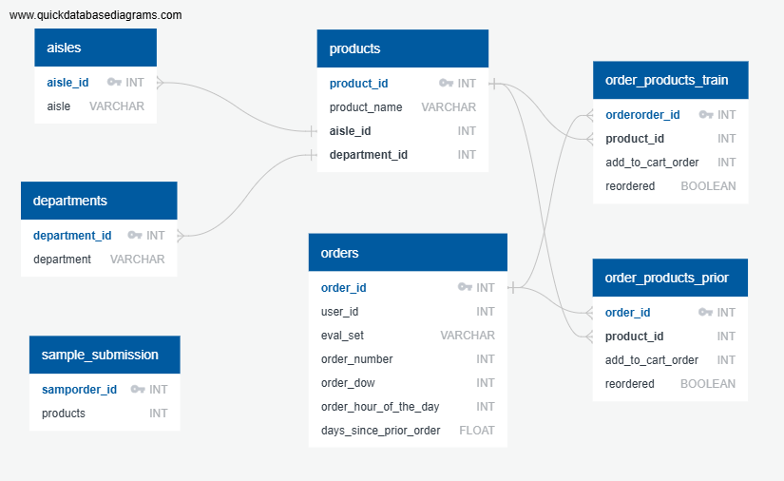

Slide 5
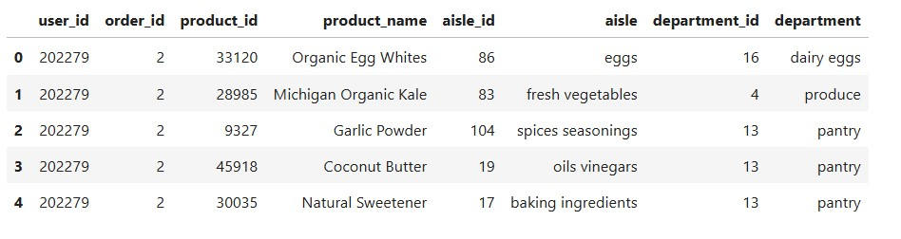
Joining the CSV together
Five CSVs (order_products_prior, products, aisles, departments, and orders) were turned into a DataFrames and then joined together. After the Four joins and cleaning up the columns, the Final DataFrame looked like

Slide 6
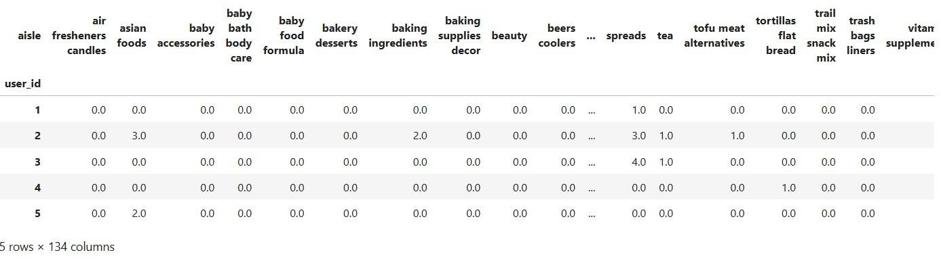
Pivot Tables (Aisles)
To best analyse the data, the Joined DataFrame was put into Pivot Tables for Aisles and Departments
aisle_pivot_table = prior_df_final.pivot_table(index='user_id', columns='aisle', values='order_id', aggfunc='count').fillna(0)

Slide 7
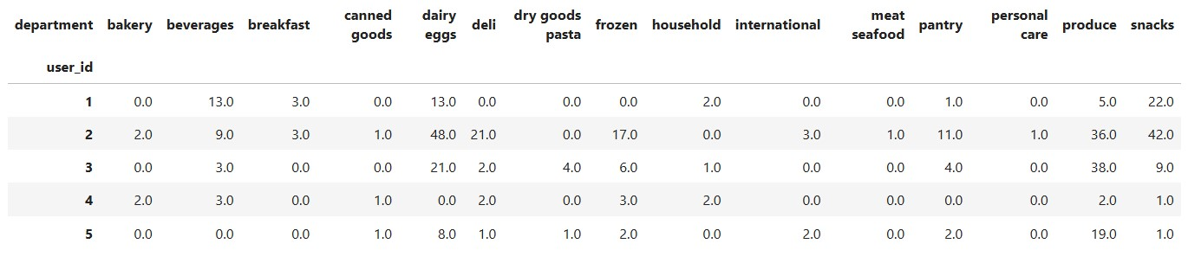
Pivot Tables (Departments)
department_pivot_table = clean_dept_df_final.pivot_table(index='user_id', columns='department', values='order_id', aggfunc='count').fillna(0)

Slide 8
Aisles
The data has 134 columns and in order to analyse tha data we had to shrink it down to 20 portions. We found that would be difficult to analyze.
In addition the data has a lot of zero values (sparse) and there isn’t a standard way to solve sparse data. For those reasons, we decided to look at the department data and that it would provide better analysis.
We attempted PCA.
Dimension Reduction using PCA
PCA Transformation: The aisle_pivot_table_2 DataFrame is reduced to 2 components using Principal Component Analysis (PCA).
The scatter plot below illustrates the separability of clusters in reduced dimensions and the original feature space, offering visual confirmation of clustering quality.

Slide 9
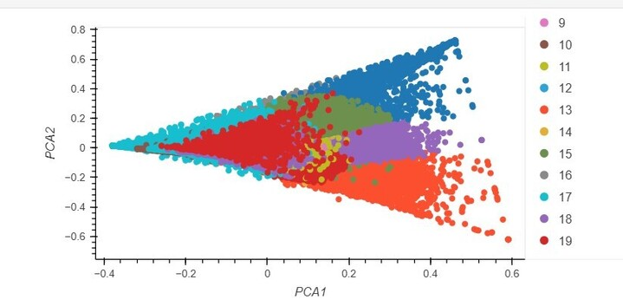
PCA

Slide 10
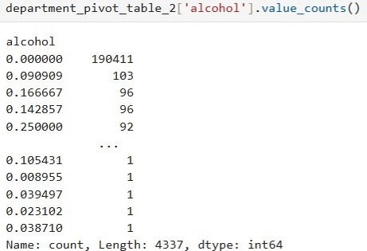
Departments
Data Clean Up
After the original pivot table was made, there was a lot of zeros in the columns. To improve the data, each department was checked to see how many values were in it. For example, less than 8% of customers ordered alcohol from this data set.
190,411 out of 206,140 users did not
order any alcohol from Instacart (92.4%)

Slide 11
Data Clean Up
Babies, Bulk, Missing, Other, and Pets departments were also removed because 16% or less of customer ordered from those departments from Instacart.
Customers dropped from 206,209 to 206,140 after the department column removals.
The remaining Departments had at least a 50% orders from customers.

Slide 12
StandardScaler vs Normalization
The data needed to be transformed to better analyze the data. Normally, StandardScaler is used to transform the data based on the rows. The problem with this dataset is there was not a quantity amount on the orders. Transforming the data with StandardScaler would minimize buyers who made a large order a few times. Therefore, the row data was normalized for each customer to see what percentage of orders came from each department.
# code to normalize the rows
department_pivot_table_2 = department_pivot_table.div(department_pivot_table.sum(axis=1), axis=0)

Slide 13
Elbow Curve
# KMeans Loop
for i in dept_k:
kmeans = KMeans(n_clusters=i, random_state=0)
kmeans.fit(department_pivot_table_2)
dept_inertia.append(kmeans.inertia_)
# Create a dictionary
dept_elbow_data = {"k": dept_k, "inertia": dept_inertia}
# Create a DataFrame using the elbow_data Dictionary
dept_df_elbow = pd.DataFrame(dept_elbow_data)

Slide 14
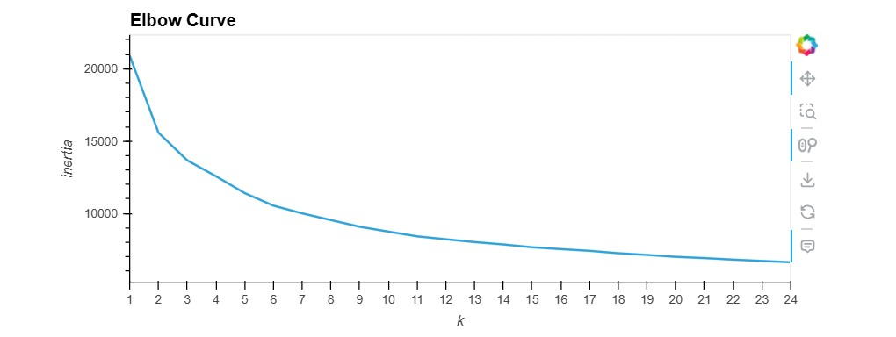

Slide 15
Machine Learning - Customer Segmentation
# fit the data to the instance of the model
model.fit(department_pivot_table_2)
#make predictions about the data cluster the pivot table
customer_dept_segs = model.predict(department_pivot_table_2)
# create a copy of the DataFrame
customer_dept_segs_predict_df = department_pivot_table_2.copy()
# Add a column to the DataFrame that contains the customer_segmentation information
customer_dept_segs_predict_df['customer segment'] = customer_dept_segs

Slide 16
Segment Data Information
segment_0 = customer_dept_segs_predict_df[customer_dept_segs_predict_df['customer segment'] == 0]
206,140 total users in six Segment
Segment 0 = 77,024 users (biggest segment)
Segment 5 = 50,111 users
Segment 2 = 32,885 users
Segment 3 = 25,817 users
Segment 4 = 10,235 users
Segment 5 = 10,068 users

Slide 17
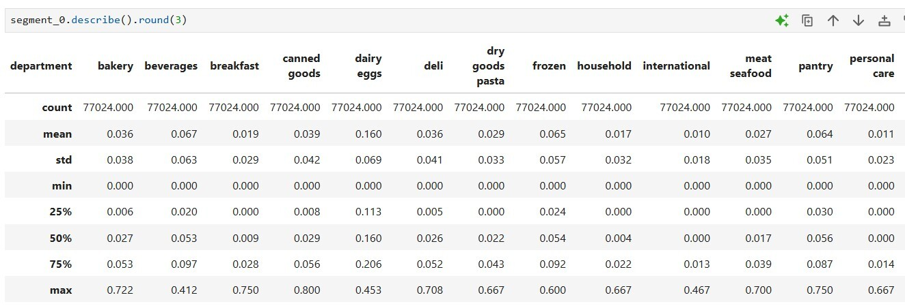
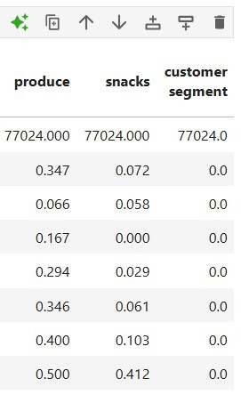
Segment 0 - “Forgotten Ingredients”
77,024 customers (biggest segment - 1st)
Eggs = 16%
Produce = 34%

Slide 18
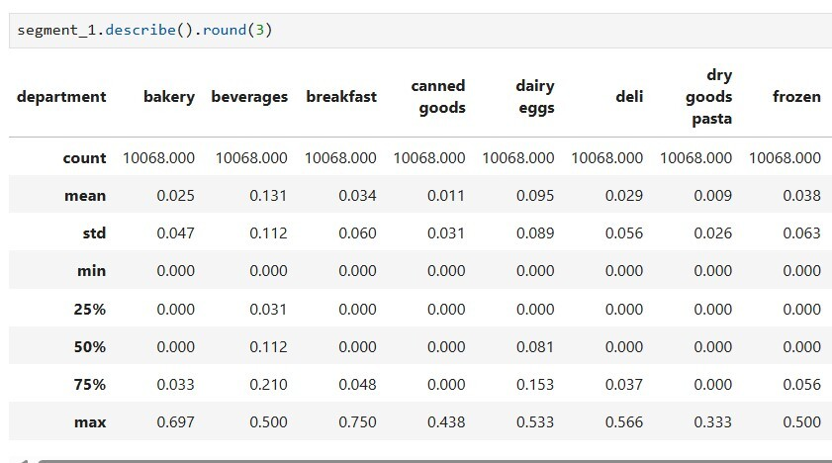
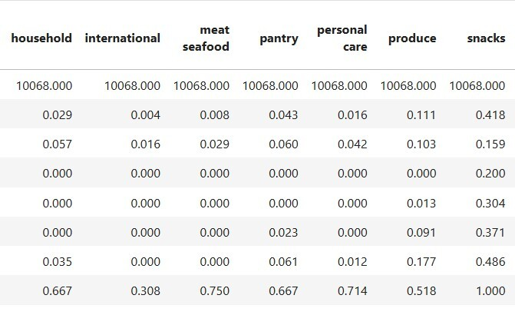
Segment 1 - “The Munchers”
10,068 customers (smallest segment - 6th overall)
13% Beverages
41% Snacks
11% Produce

Slide 19
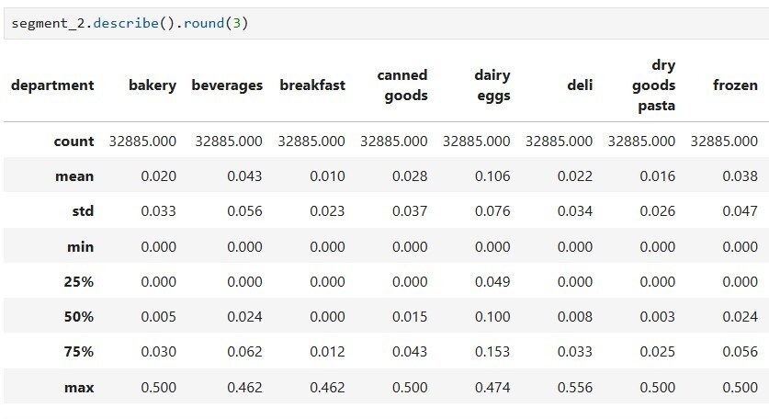
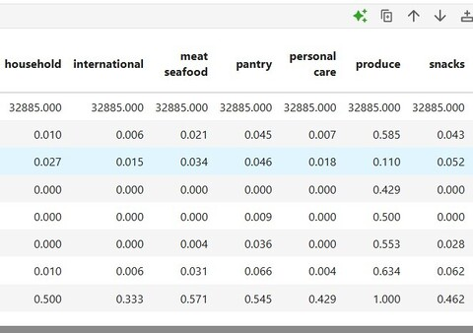
Segment 2 -”Organic”
32,885 customers (3rd biggest segment)
58% = Produce
10% = Eggs

Slide 20
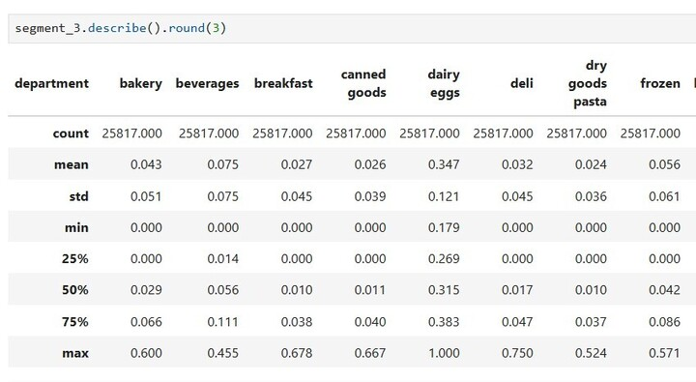
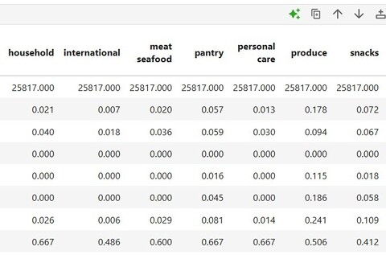
Segment 3 - “The Rise and Grinds”
25,817 customers (4th biggest segment)
18% = Produce
35% = Eggs

Slide 21
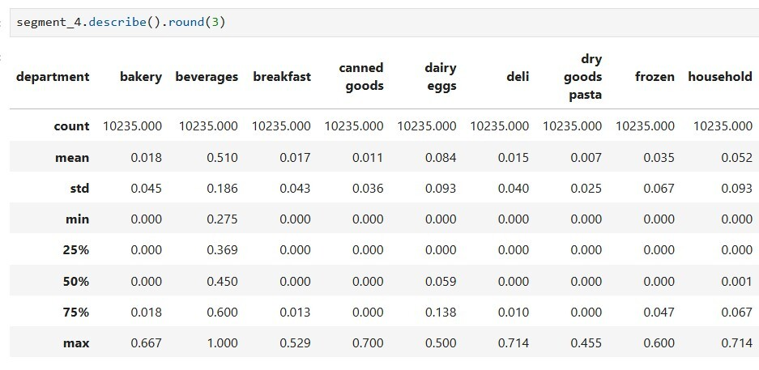
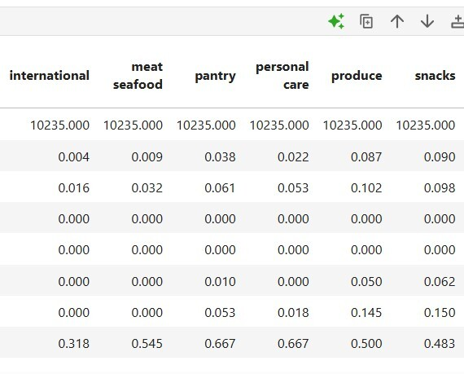
Segment 4 - “The Thirsty’s”
10,235 customers (2nd smallest segment - 5th overall)
51% = Beverages

Slide 22
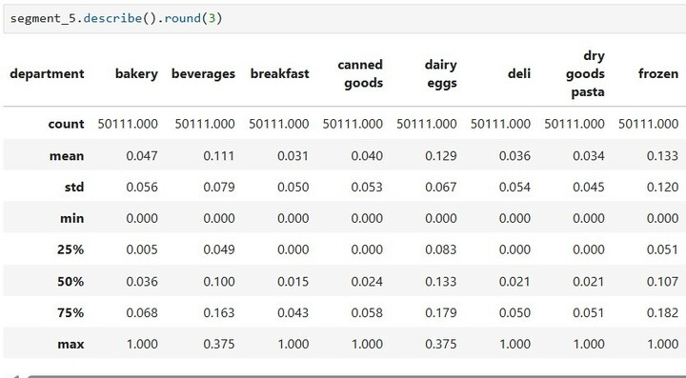
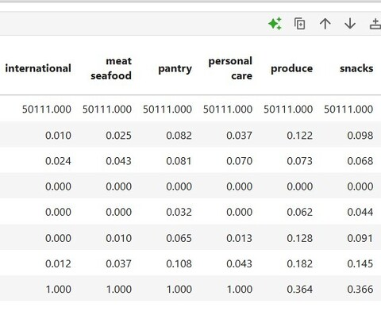
Segment 5 - “The Family”
50,111 customers (2nd biggest segment)
Eggs = 12%
Frozen = 13%
Beverages = 11%
Produce = 12%

Slide 23
Limitations
No quantity was listed. We don’t know how many items were ordered, only the specific food.
Limited since most people are not ordering their Meat and Seafood through InstaCart.

